Slide 1


NEXT GEN EMPLOYABILITY PROGRAM
CREATING A FUTURE-READY WORKFORCE
Student Name :
Samruddhi Wakchaure
Student ID :
College Name :
STU671a7aa0692341729788576
Amrutvahini College of Engineering, Sangamner

Slide 2
CAPSTONE PROJECT SHOWCASE
Project Title
Personal Finance Manager
Abstract | Problem Statement | Project Overview | Proposed Solution | Technology Used | Modelling & Results | Conclusion | Q&A

Slide 3
Abstract
1
A comprehensive web-based tool for managing personal finances.
2
Enables users to track income, expenses, and savings in one place.
3
Provides financial insights through data visualization and analytics.
4
Ensures data security with authentication and encrypted storage.

Slide 4


Problem Statement
Managing personal finances is challenging due to time-consuming manual tracking, lack of real-time insights, and security concerns. There is a need for a secure, user-friendly system that enables real-time expense tracking, budgeting, and financial forecasting.

Slide 5

Project Overview
A responsive web application for finance management.
Users can add, edit, and categorize financial transactions.
Real-time balance updates based on recorded transactions.
Data visualization to analyze financial trends effectively.
Ensures security with authentication and data encryption.

Slide 6
Proposed Solution
A secure and intuitive web-based personal finance management system that enables users to efficiently record and categorize transactions. It features real-time dashboards for tracking income, expenses, and savings, with data visualization through charts and graphs for better financial insights. Secure authentication using JWT ensures data protection, while advanced filtering and search functionalities enhance user convenience.

Slide 7
Technology used
Frontend: React.js, Bootstrap for responsive UI.
Backend: Node.js, Express.js for server-side logic.
Database: MongoDB for efficient data storage.
Authentication: JWT-based secure user login.
Development Tools: Git, GitHub, and Postman for testing.

Slide 8
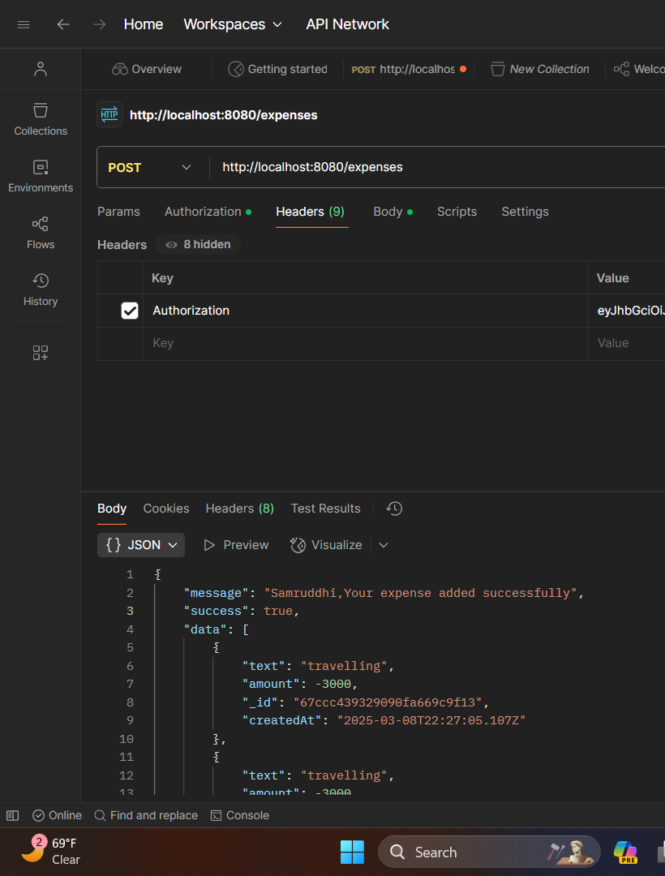
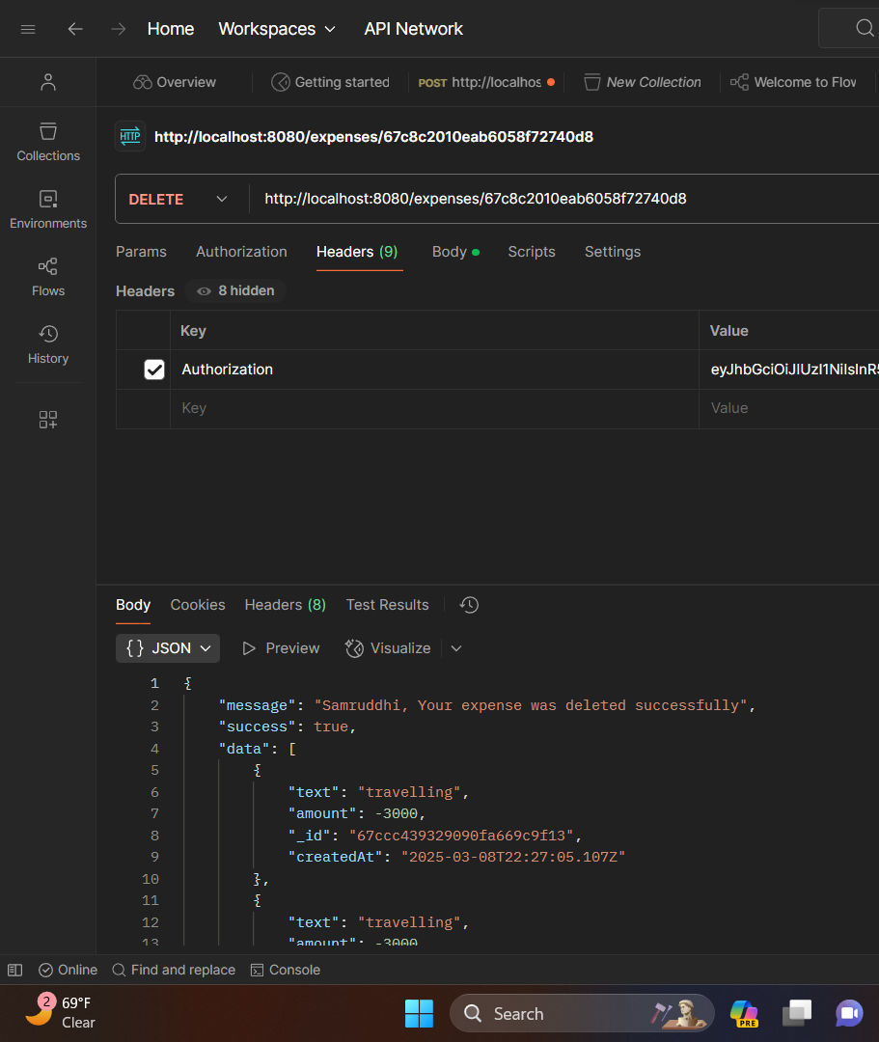
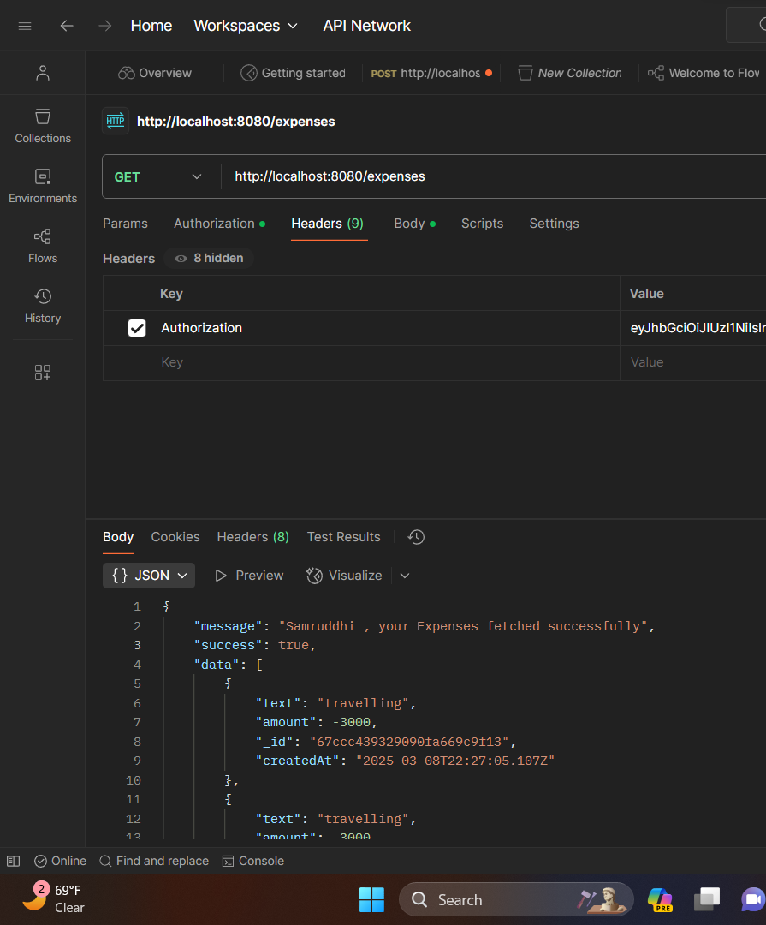
Modelling
Tested working of project using POSTMAN
deleted
Added
fetched

Slide 9
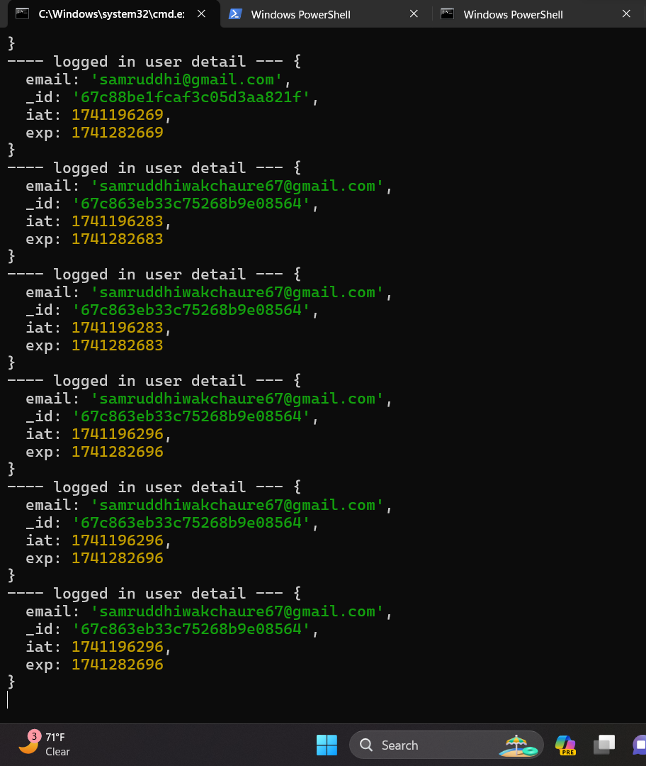
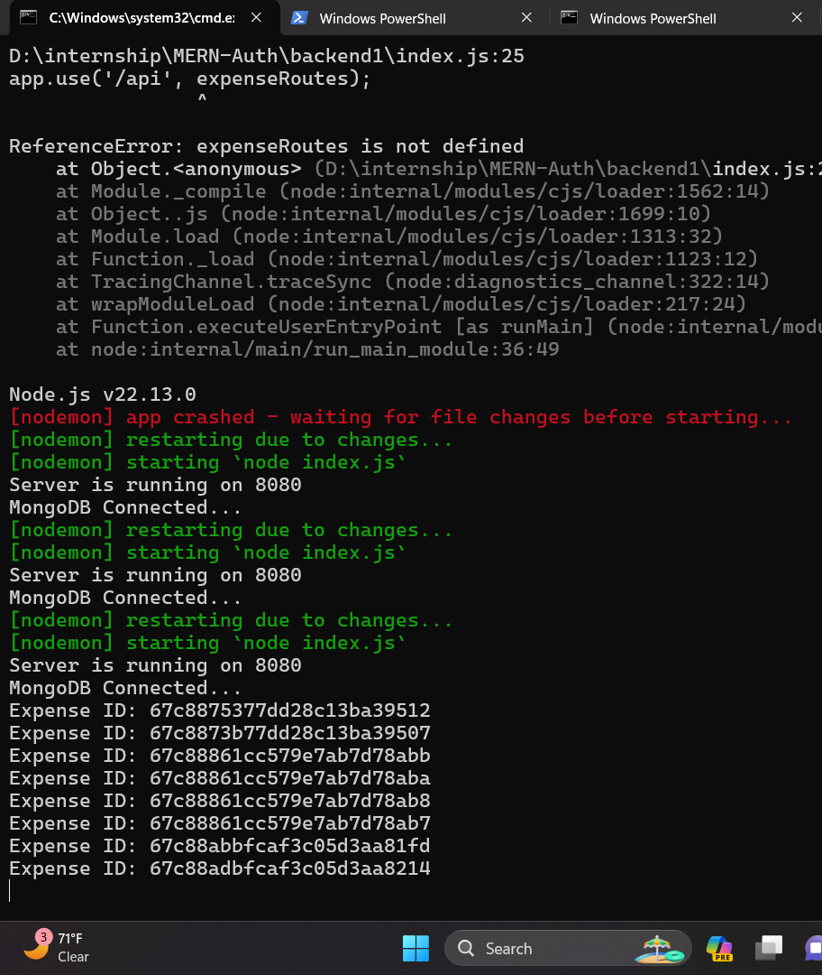
Actual Working when MongoDB connected

Slide 10
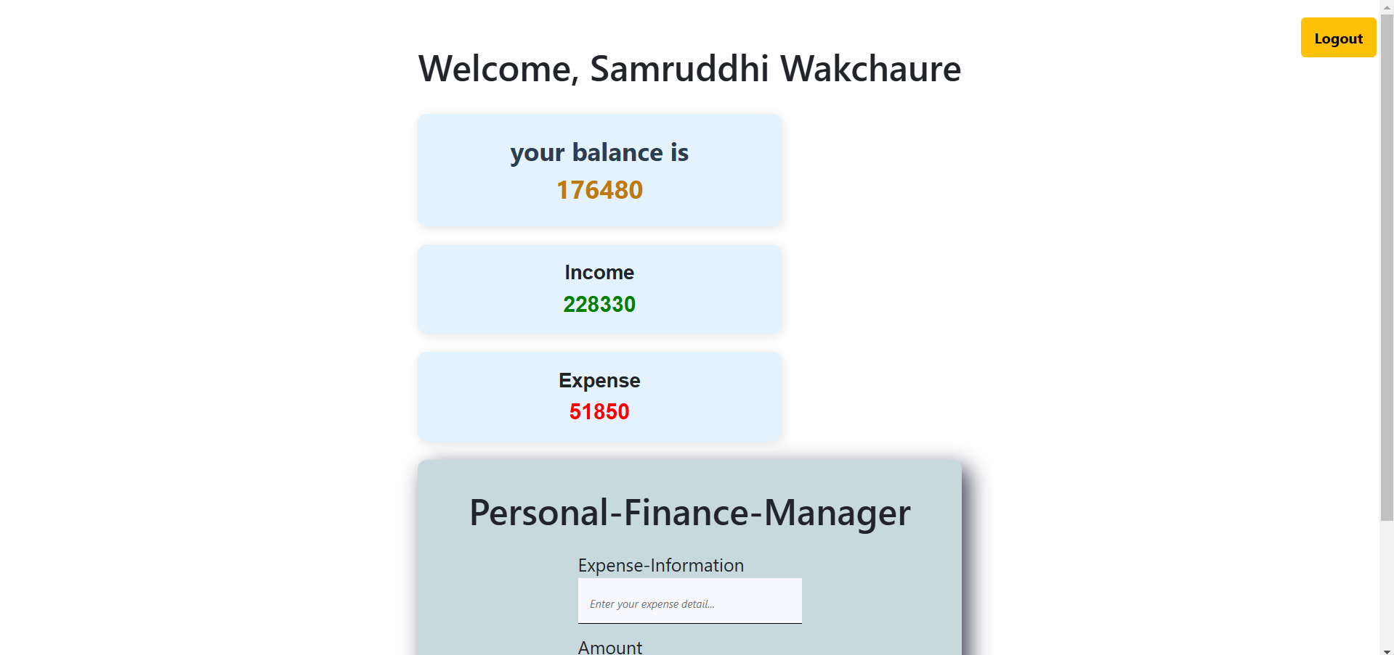
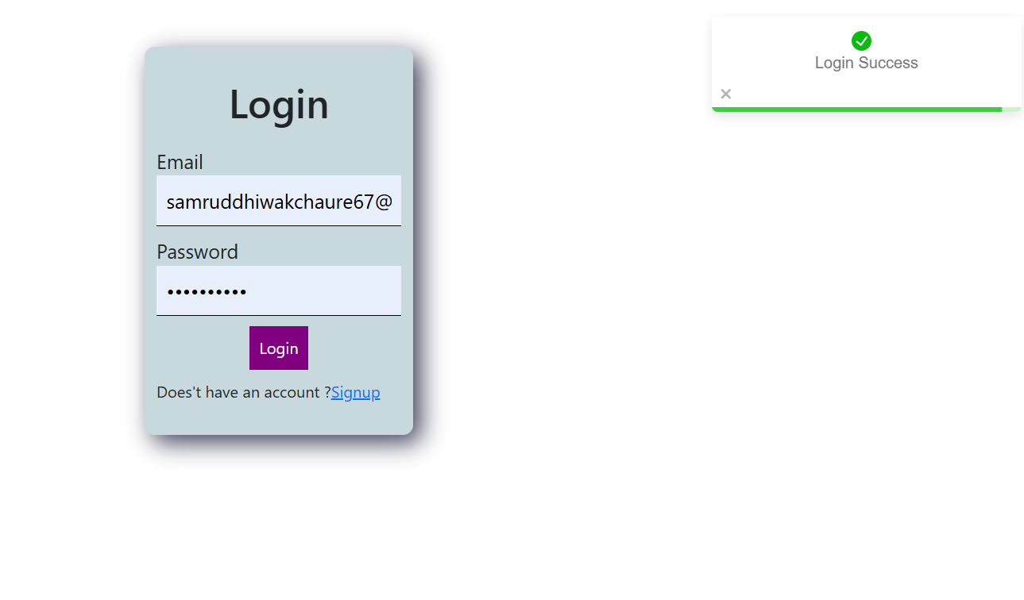
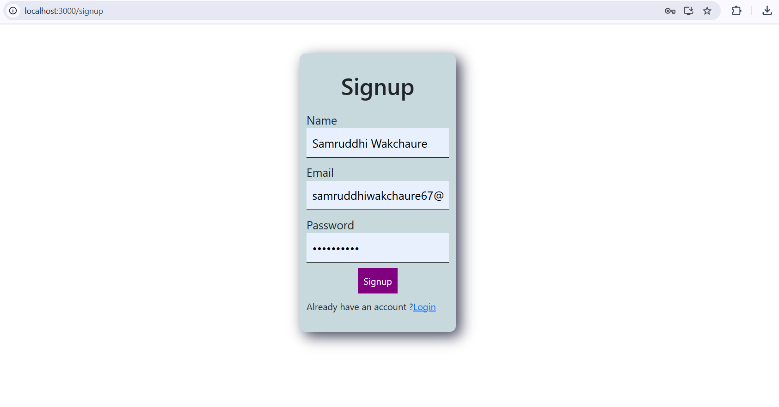
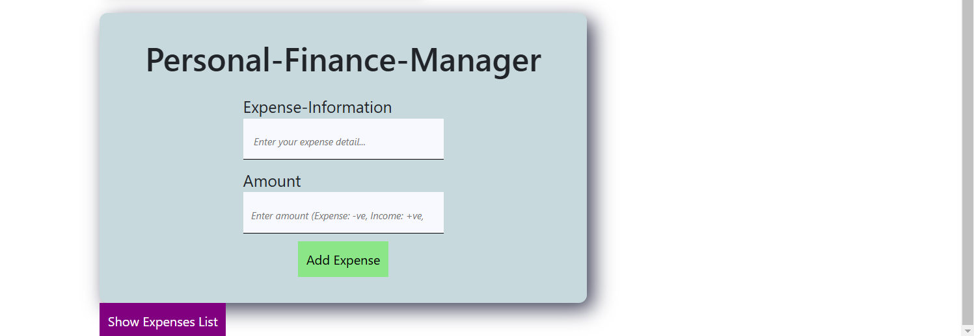
Modelling & Result
Home page
Login page
Signup page
Logout Button

Slide 11
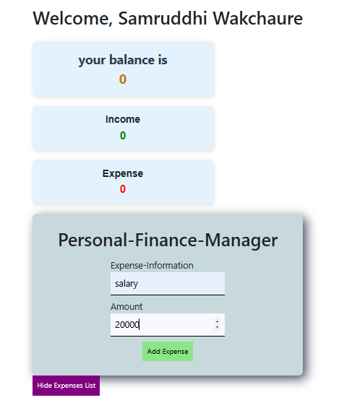
Modelling & Result
When income is added it will add in expenses list with green color
When expense is added it will add in expenses list with red color
At this time Total Balance, Income, Expense will be updated

Slide 12
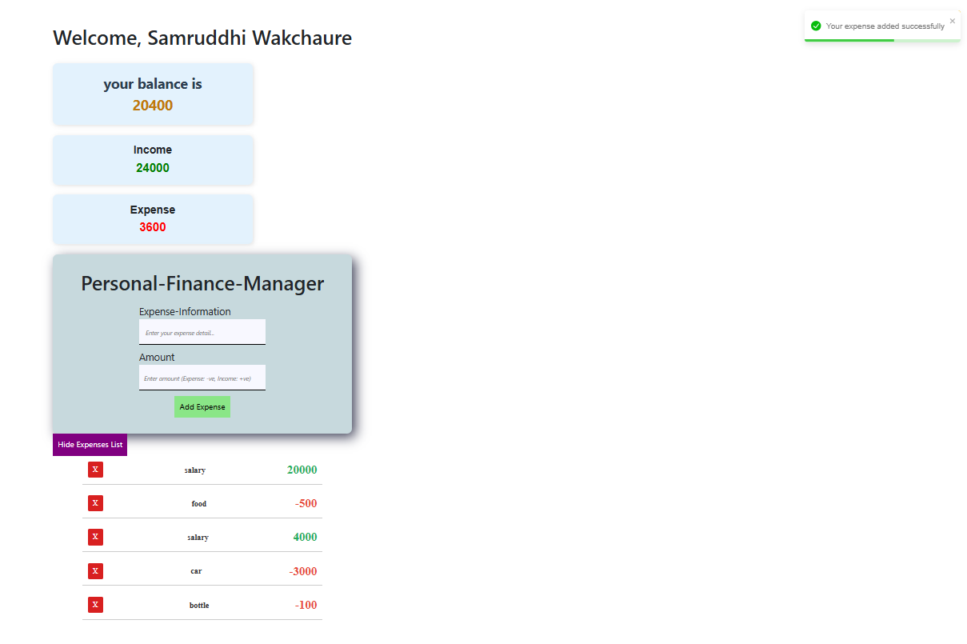
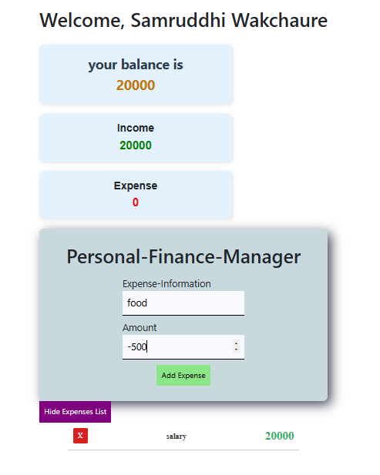
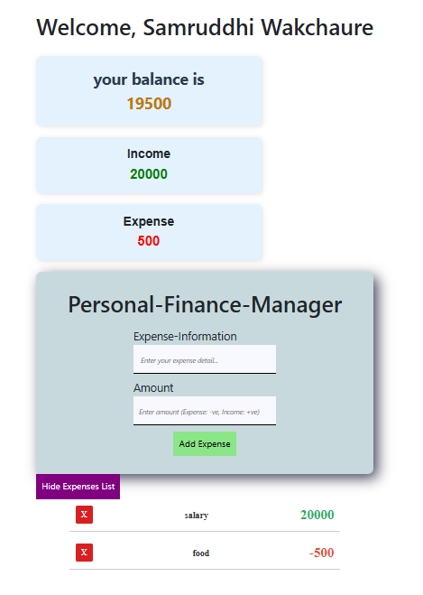
Adding expenses

Slide 13
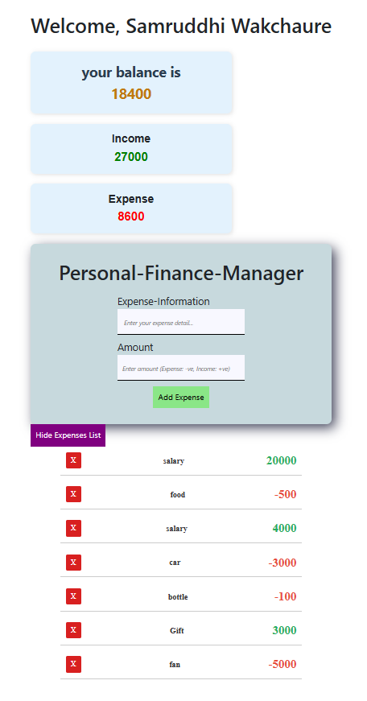
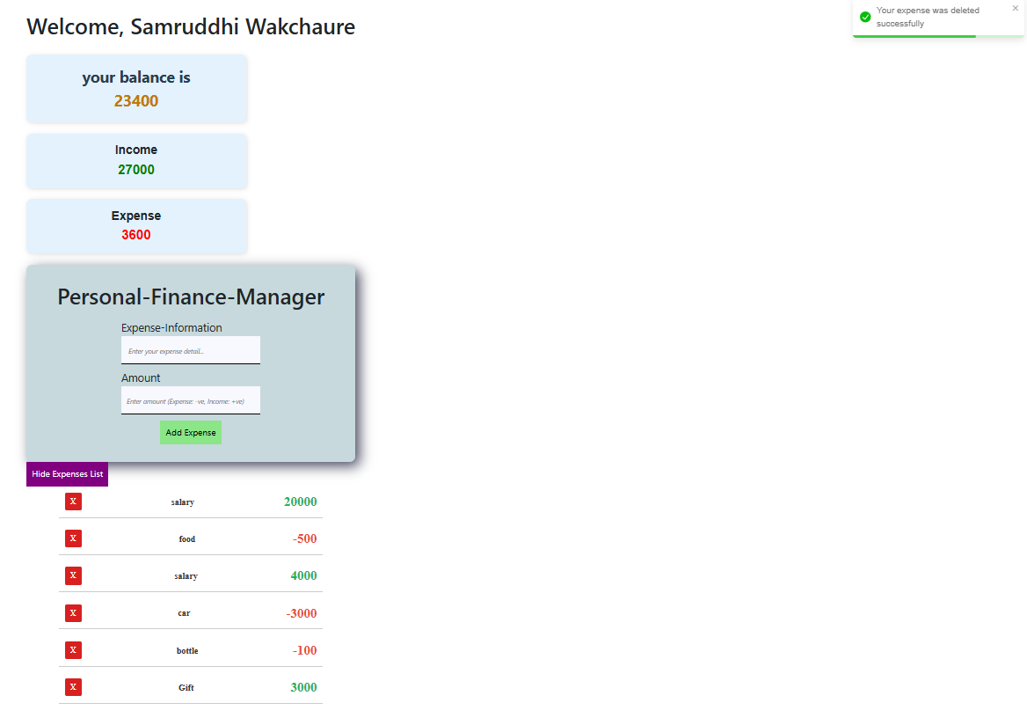
Similarly, we can delete expense by clicking on red(X) button
At this time Total Balance, Income, Expense will be updated
Also item will be delete from list
Here, we deleted expenses of fan successfully

Slide 14

Conclusion
Developed a practical and efficient finance tracking system.
Helps users manage budgets and track expenses effortlessly.
Provides real-time financial insights with an intuitive UI.
Secure authentication ensures user data privacy.
Future scope includes AI-based financial forecasting and bank API integration.

Slide 15


Notes:
Thank You !!

